Slide 1
Fraud Detection Data Analysis

Slide 2
Data Processing & Cleaning
CARDS DATA:
No duplicates, no nulls
Considerations
The column card_on_dark_web has a constant value.
Issues Found:
The column Expires and acct_open_date is misassiged as object and should be datetime.
credit_limit column is misassigned as object It should be numeric.

Slide 3
Users Data
No duplicates, no nulls
The columns 'per_capita_income', 'yearly_income' and 'total_debt' columns are assigned as object. Resolving the issue and changing the datatype to numeric.
3. MCC CODES
No duplicates, no nulls
The column 'mcc' is misassigned as 'object' and should be 'int'
4. TRANSACTIONS
Observations:
The 'Amount' column is wrong wrongly assigned as 'Object' due to the presence of '$' in the value.
Issues found:
Presence of negative values in the amount column
Presence of NAN values in 'errors' column

Slide 4
Dataset Overview
8.91 million labeled transactions
Suitable for fraud classification, clustering, and time series (LSTM)
Fraud distribution:
Legit: 8,901,631 (99.85%)
Fraud: 13,332 (0.15%)
Severe imbalance → Oversampling, undersampling, or class_weight techniques required

Slide 5
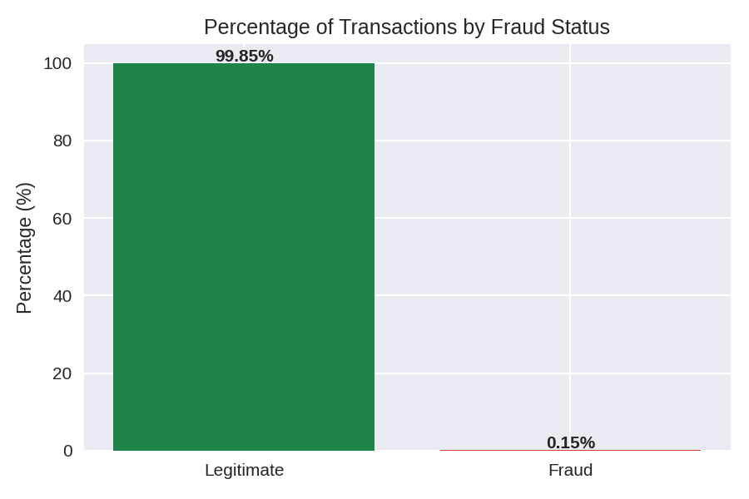
Modeling Preparation & Metrics
Interpretation:
One can see major imbalance in the fraud status column.
Considerations:
If a classification task is to be performed then it is important to ensure balanced learning for the model, considering the imbalance a hybrid strategy of undersampling of the majority class and oversampling of the minority class seems like a good option to consider.

Slide 6
Transaction Amount Distribution
Most transactions < $200
Skewed distribution with extreme outliers (> $1000)
Fraud vs. Legit not distinguishable by amount alone
Suggestion: log(amount + 1) transformation or engineered features

Slide 7
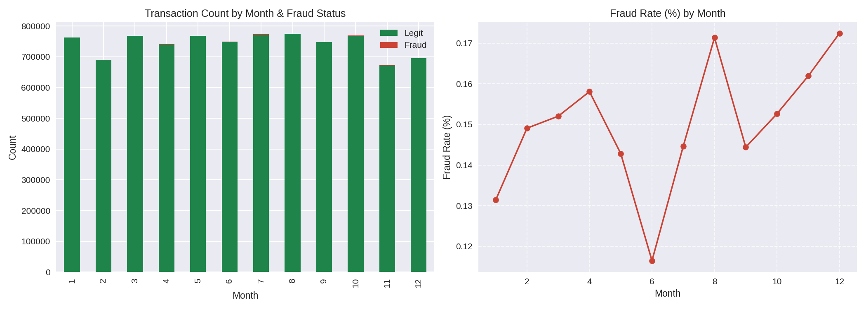
Transaction Time Distribution
Transactions concentrated 6am–4pm, peak 11am–1pm
Very low activity between 0am–5am
Useful time-based feature for behavior modeling and LSTM

Slide 8
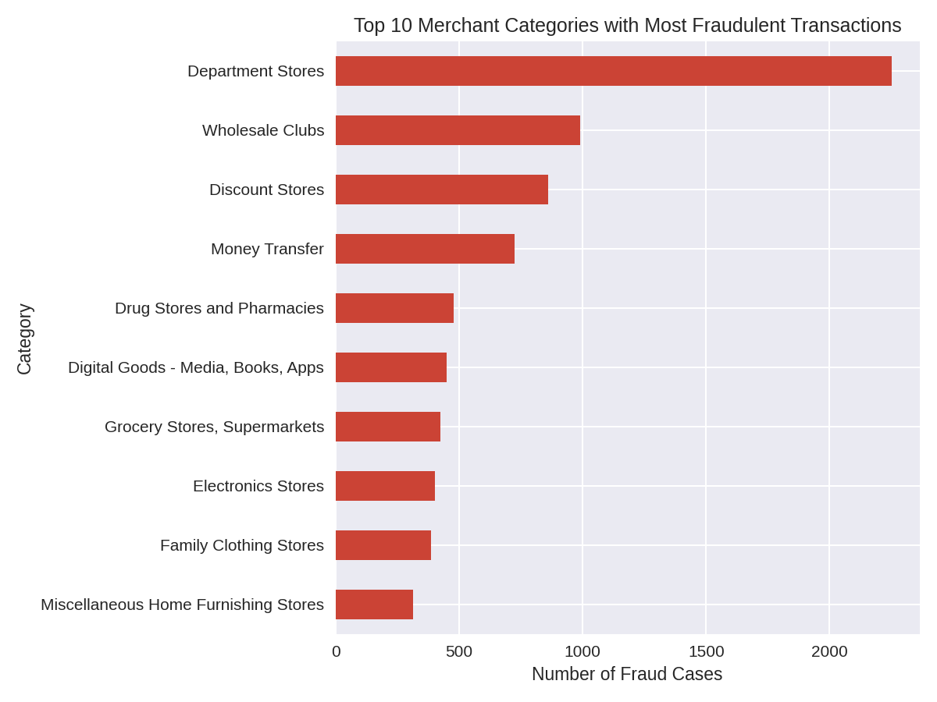
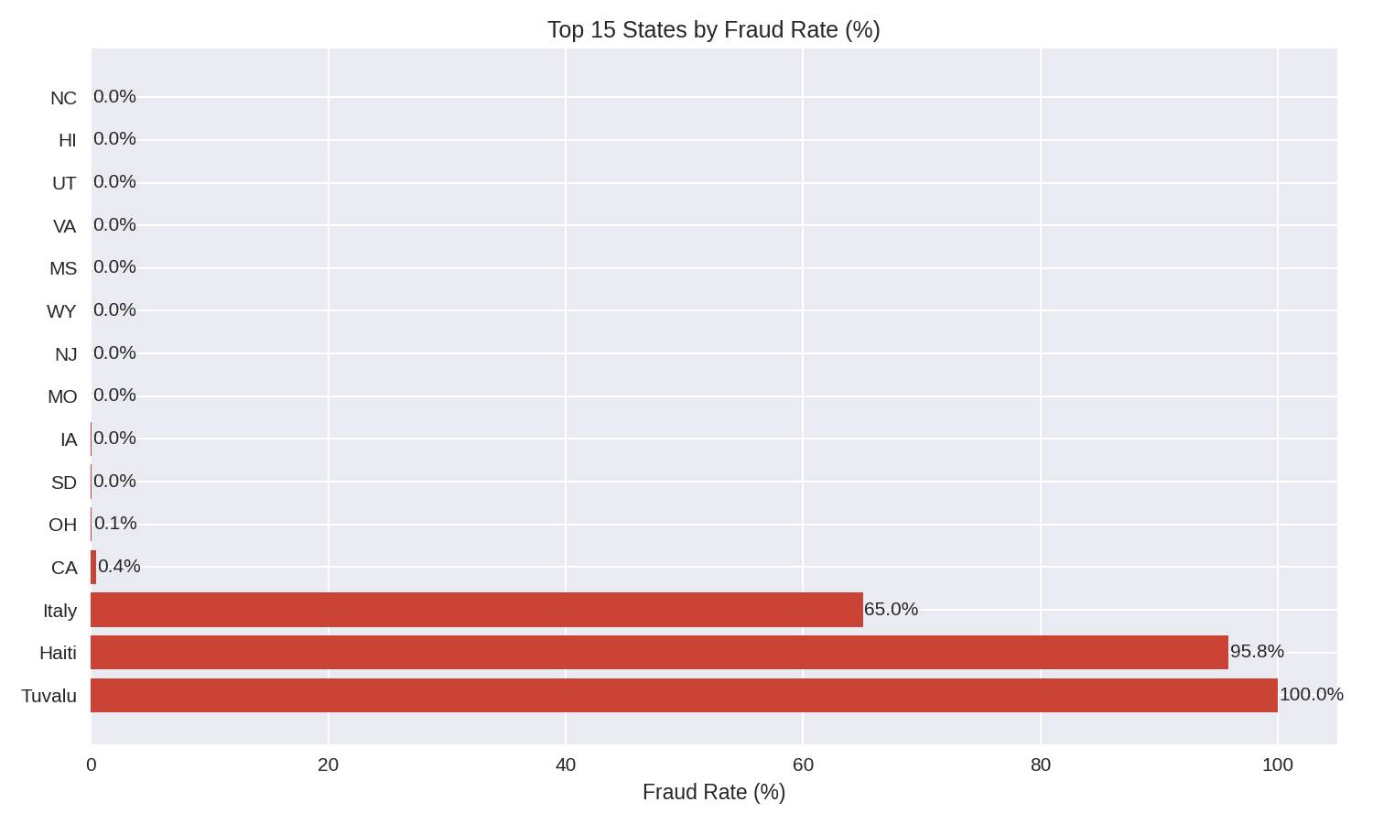
States & Categories with most fraud
States with Most Fraud Rate
Tuvalu
Haiti
Italy
Merchants Categories with Most Fraud Rate
Department Stores
Wholesale Clubs
Discount Stores

Slide 9
Fraud Analysis by Features
• amount_range: High group has highest fraud (1.22%)
• age_group: Higher fraud in seniors and middle-aged
• income_level: Low-income at higher risk (0.16%)
• credit_score_group: 'Fair' scores most risky
• used_chip: Non-chip transactions riskier (0.17% vs 0.09%)
• is_weekend: Slightly higher fraud risk

Slide 10
Feature Distribution
amount_range: 67% transactions under $50
age_group: 70%+ users aged 40+
income_level: Even split between low and middle income
credit_score_group: Mostly 'fair' and 'good'
used_chip: Majority without chip
card_type: Mostly debit, then credit
gender: Nearly balanced
is_darkweb: Constant

Slide 11
Summary & Next Steps
The data is rich in behavioral and demographic features, enough for complex problems.
The fraud rate is low, so it is necessary to use techniques to handle label imbalance.
Some features such as used_chip, amount_range, is_weekend, income_level show that there are signals to distinguish fraudulent behavior.

